Slide 1
M.TECH ARTIFICIAL INTELLIGENCE AND MACHINE LEARNING
TRAFFIC ACCIDENT ANALYSIS & SEVERITY RISK MODELING
An Exposure-Adjusted Visual Analytics Framework for Proactive Highway Safety & Hazard Identification
Fall Semester 2026 | Visual Analytics Lab
SUBMITTED BY:
Saranya Dalal [26MML0007]
Divya Pujari [26MML0009]
Rohan Yadav [26MML0020]
Faculty Guide:
Dr. Manikandan K
School of Computer Science and Engineering (SCOPE)

Slide 2
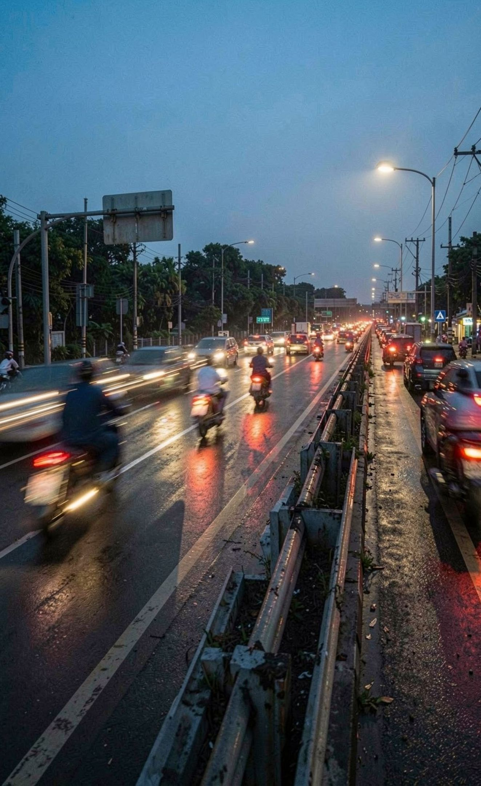
ABSTRACT — PROBLEM STATEMENT
Traffic accidents are influenced by interacting temporal, spatial, environmental and roadway factors.
Conventional safety analysis relies heavily on raw accident counts to identify dangerous road segments.
High-traffic roads may accumulate many minor crashes, while low-traffic roads may experience fewer but more severe accidents.
This creates a severity-frequency paradox, where crash frequency alone can misrepresent actual risk.
This project develops an exposure-adjusted visual analytics framework to identify high-risk road segments and support proactive highway safety interventions.
Research Problem: How can accident severity, traffic exposure, temporal patterns and environmental conditions be integrated to identify genuinely high-risk road segments?
2

Slide 3
OBJECTIVES
01
02
Temporal Risk Analysis
Spatial Hotspot Identification
Identify dangerous hours, days and seasonal patterns associated with increased accident severity.
Locate high-risk road segments using severity-weighted, exposure-adjusted risk measures.
03
04
Environmental Risk Assessment
Vulnerable Road User Analysis
Analyse the influence of weather, road surface conditions, visibility and roadway illumination.
Investigate severity differences across vehicle categories and speed-limit regimes.
05
06
Predictive Modelling
Interactive Visual Analytics
Use Random Forest classification to identify important factors associated with severe crashes.
Develop a dashboard for exploring crash patterns, high-risk locations and potential safety interventions.
3

Slide 4

LITERATURE REVIEW — KEY FINDINGS
Traditional Crash Hotspot Models
Visual Analytics and Spatial Modelling
Identify dangerous locations using crash frequency and historical accident patterns. May overlook low-frequency locations with severe outcomes.
Integrate geographic, temporal and environmental information. Support interactive exploration and evidence-based decision-making.
Exposure-Based Risk Modelling
Key Limitation: Many conventional approaches do not jointly integrate severity weighting, roadway exposure and interactive visual analysis.
Normalises crash outcomes using traffic volume and roadway exposure. Supports fairer comparisons between roads carrying different traffic volumes.
Machine Learning for Road Safety
Random Forest, XGBoost, SVM and graph-based models support severity prediction and hotspot identification. Explainable AI methods help identify influential risk factors.
4

Slide 5

RESEARCH GAP — FRAMING OUR CONTRIBUTION
Frequency vs. Severity
Predictive Severity Attribution
Move beyond raw crash counts to identify locations where severe outcomes are disproportionately high.
Use machine learning to identify the factors most strongly associated with severe crashes.
Exposure Normalisation
Actionable Safety Planning
Account for traffic volume and road-segment length when comparing roadway risk.
Translate analytical findings into targeted engineering interventions and policy recommendations.
Integrated Risk Analysis
Primary Research Gap: Lack of an integrated, severity-aware and exposure-adjusted visual analytics framework for proactive road safety prioritisation.
Combine temporal, spatial, environmental and vehicle-related factors in one analytical framework.
5

Slide 6
PROPOSED SYSTEM DESIGN & ARCHITECTURE
01
02
03
Data Collection
Data Preprocessing
Feature Engineering
UK STATS19 collision records; OpenStreetMap road-network data; Annual Average Daily Traffic (AADT); Open-Meteo historical weather observations
Handle missing values and duplicates; validate geographic coordinates; match crashes to road segments; integrate datasets using spatial and temporal attributes
Hour, day and month; weather and road conditions; vehicle category and crash severity; road geometry, speed limit and traffic exposure
04
05
06
Analytical Modelling
Visual Analytics
Decision Support
Exploratory data analysis; severity-weighted risk calculation; temporal and spatial hotspot analysis; Random Forest severity classification
Geographic hotspot maps; temporal heatmaps; environmental risk comparisons; interactive roadway risk classification
Identify priority road segments; compare safety interventions; support data-driven infrastructure planning
6

Slide 7
DATA INGESTION — MULTIPLE DATA SOURCES
UK STATS19 | — Collision records and severity — Accident analysis
OpenStreetMap | — Road geometry, road class and segment attributes — Spatial mapping
AADT data | — Average daily traffic volume — Exposure estimation
Open-Meteo | — Historical weather observations — Environmental risk analysis
Dataset Overview
22,000 UK STATS19 collision records
160 roadway segments in the benchmark network
Crash-level data integrated with roadway, traffic and weather attributes
Road-segment-level aggregation used for exposure-adjusted risk analysis
Geographic Strategy UK network used for the principal analysis because collision and traffic-exposure data can be integrated. Bengaluru arterial corridors used as an emerging-market transferability case study.
Key Engineering Challenge: Integrating datasets with different spatial and temporal resolutions into a consistent analytical framework.
7

Slide 8

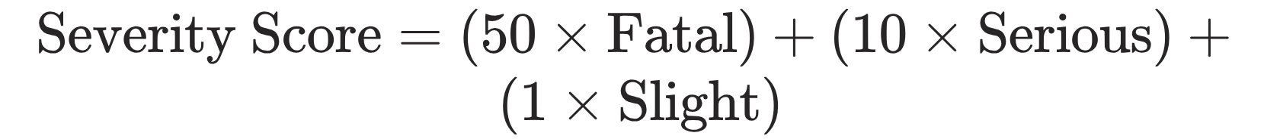


METHODOLOGY — WHERE EXPOSURE ENTERS
01
02
Annual Roadway Exposure
Severity-Weighted Crash Score
AADT: Annual Average Daily Traffic
Segment length: Road length in kilometres
Exposure measured in Million Vehicle-Kilometres (MVKM)
Severity weights are based on published UK Department for Transport injury-cost ratios.
03
04
Exposure-Adjusted Risk Index
Statistical Suppression
Apply minimum crash-count and exposure thresholds. Withhold unstable estimates where very low exposure could produce misleadingly large risk values.
Represents severity-weighted crash outcomes relative to roadway exposure.
Key Principle: Compare roads using both the severity of crashes and the amount of traffic exposure, rather than relying on accident counts alone.
8

Slide 9
RESULTS — ONE-EIGHTH THE CRASHES, OVER TWELVE TIMES THE RISK
M25 INTERCHANGE (SEG-0417)
B4009 CHILTERN RIDGE CURVE (SEG-1902)
M25 Interchange (SEG-0417)
B4009 Chiltern Ridge Curve (SEG-1902)
Number of crashes: 47
Annual exposure: 27.1 MVKM
Severity-weighted score: 186
Risk index per MVKM: 6.86
Risk ranking: #152
Number of crashes: 6
Annual exposure: 2.5 MVKM
Severity-weighted score: 213
Risk index per MVKM: 84.40
Risk ranking: #2
The M25 interchange records substantially more crashes but has much greater traffic exposure.
The B4009 curve records only six crashes but has a substantially higher exposure-adjusted risk index.
Exposure adjustment changes the prioritisation of road segments.
Raw crash counts alone may direct resources away from low-volume, high-severity locations.
Central Insight: A road with fewer crashes can represent a much greater safety risk once severity and traffic exposure are considered.
9

Slide 10

TEMPORAL & ENVIRONMENTAL RISK DYNAMICS
Temporal Patterns
Weather-Related Hazards
Darkness & Road Illumination
Fatality rates peak at 6.82% during 02:00–05:00.
Friday and Saturday late-night periods show elevated severity.
Reduced traffic volume during the early morning does not necessarily imply reduced risk.
Adverse weather can reduce visibility and road-surface friction.
Fog and mist create additional stopping-distance and visibility challenges.
Compound hazards are associated with more severe crash outcomes.
The report records a fatality rate of 10.93% under unlit darkness, compared with 3.36% in daylight.
Unlit rural roads warrant particular attention when combined with wet surfaces or adverse weather.
Implication: Road safety interventions should account for the interaction of time, lighting, weather and roadway conditions, rather than treating these factors independently.
10

Slide 11
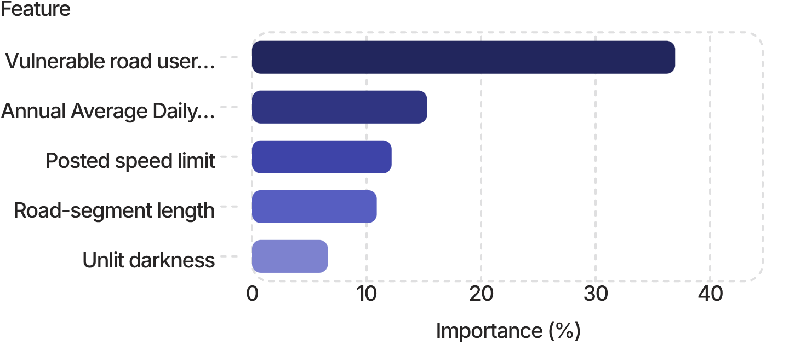
PREDICTIVE MODELLING & SAFETY INTERVENTIONS
Random Forest Classifier Target: Severe crashes (fatal and serious) versus non-severe crashes. Overall accuracy: 87.12% ROC-AUC: 0.884 Severe-class precision: 74.52% Severe-class recall: 72.80%
Top Predictive Features
Bengaluru Transferability Case Study Examines five arterial corridors under mixed-traffic conditions. Kanakapura Highway (NH-948) has a reported risk index of 56.82 per MVKM. The report highlights the vulnerability associated with a high two-wheeler modal share.
Potential Safety Interventions
Improve lighting on high-risk rural roads.
Reduce speeds at high-risk locations.
Introduce physically segregated lanes for vulnerable road users.
Improve road-surface friction and hazard warning systems.
11

Slide 12
CONCLUSION
Key Conclusions
Future Scope
Raw crash counts alone can misrepresent roadway danger.
Exposure-adjusted severity analysis reveals high-risk locations that conventional hotspot methods may overlook.
Early-morning periods, unlit road conditions and compound environmental hazards are associated with elevated severity.
Vulnerable road users require targeted protection, particularly on high-speed and mixed-traffic corridors.
Random Forest modelling provides useful predictive insight into factors associated with severe crashes.
Incorporate real-time traffic and weather feeds.
Integrate vehicle telematics and near-miss data.
Validate the framework on larger, diverse regional datasets.
Develop proactive risk alerts for Intelligent Transportation Systems (ITS).
12

Slide 13
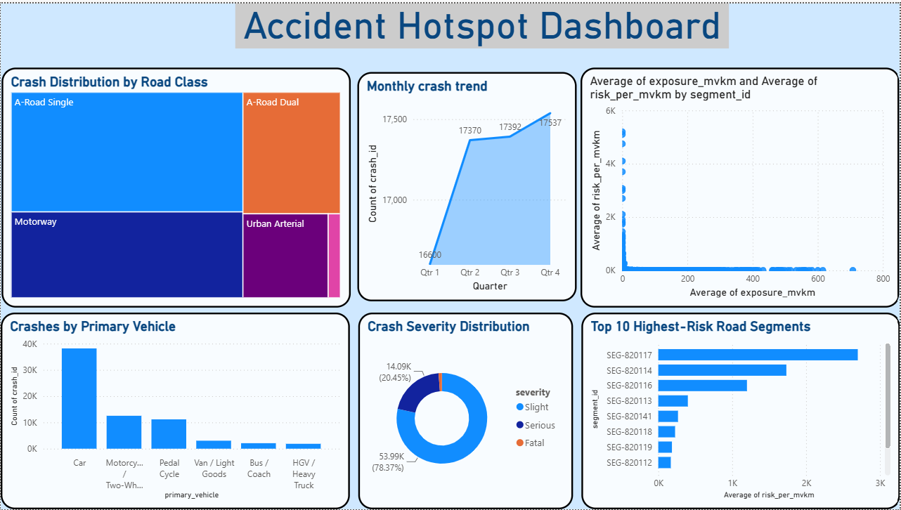

Slide 14
Thank you

